Slide 1

Class6
CSC 495/583 Topics of Software Security Stack Overflow
Dr. Si Chen (schen@wcupa.edu)

Slide 2
Review

Slide 3
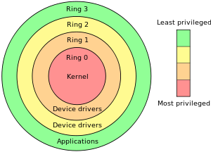
System Call

Slide 4
fwrite() path in both Linux and Windows
Application
fwrite()
./program
fwrite()
program.exe
C
Run Time
Library
write()
libc.a
libc.so
write()
Libcmt.lib
msvcr90.dll
libc.a
libc.so
interrupt 0x80
API (Windows)
NtWriteFile()
Kernel32.dll
NTDLL.dll
Interrupt 0x2e
Kernel
sys_write()
Kernel
./vlinuxz
IoWriteFile()
Kernel
NtosKrnl.exe

Slide 5
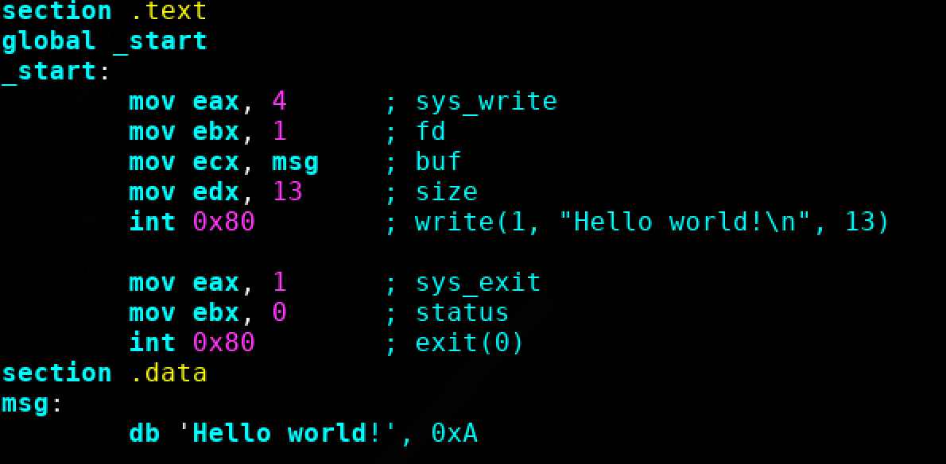
Example: Hello World
Quick review:
DB - Define Byte. 8 bits
DW - Define Word. Generally 2 bytes on a typical x86 32-bit system
DD - Define double word. Generally 4 bytes on a typical x86 32-bit system
From x86 assembly tutorial,
helloworld.asm

Slide 6
“Memory Corruption”
What is it?

Slide 7
“Memory Corruption”
Modifying a binary’s memory in a way that was not intended
Broad umbrella term for most of what the rest of this class will be
The vast majority of system-level exploits (real-world and competition) involve memory corruption

Slide 8
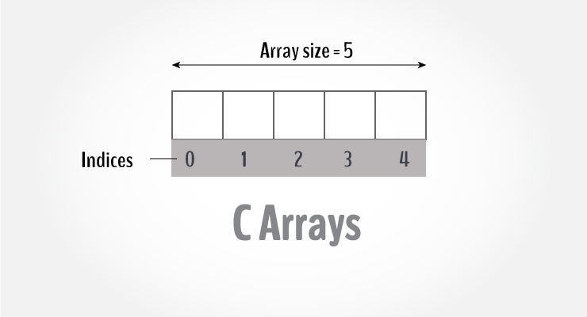
Buffers
A buffer is defined as a limited, contiguously allocated set of memory. The most common buffer in C is an array.

Slide 9
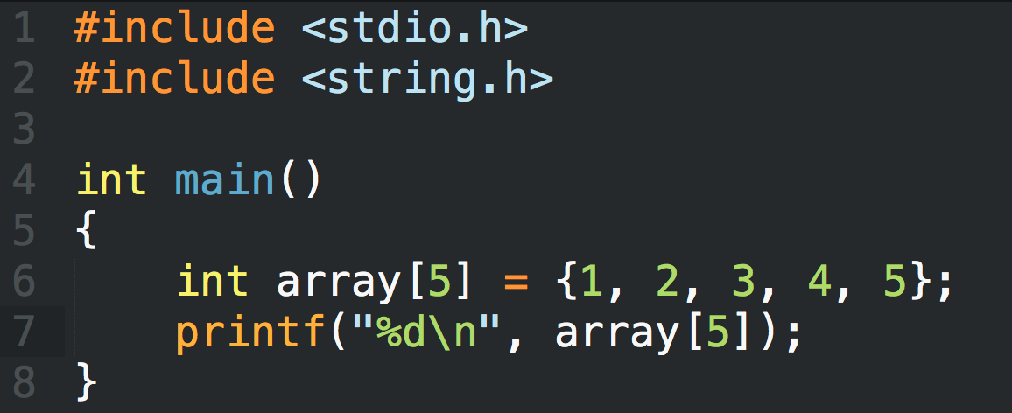
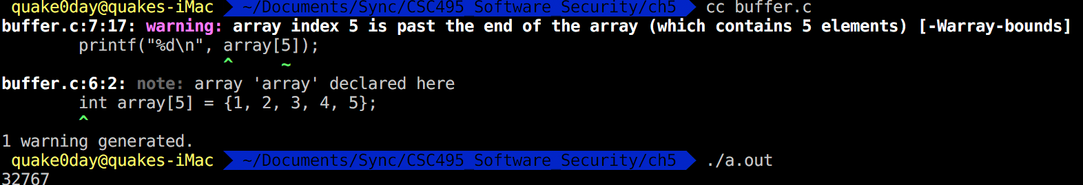
A novice C programmer mistake
This example shows how easy it is to read past the end of a buffer; C provides no built-in protection.

Slide 10
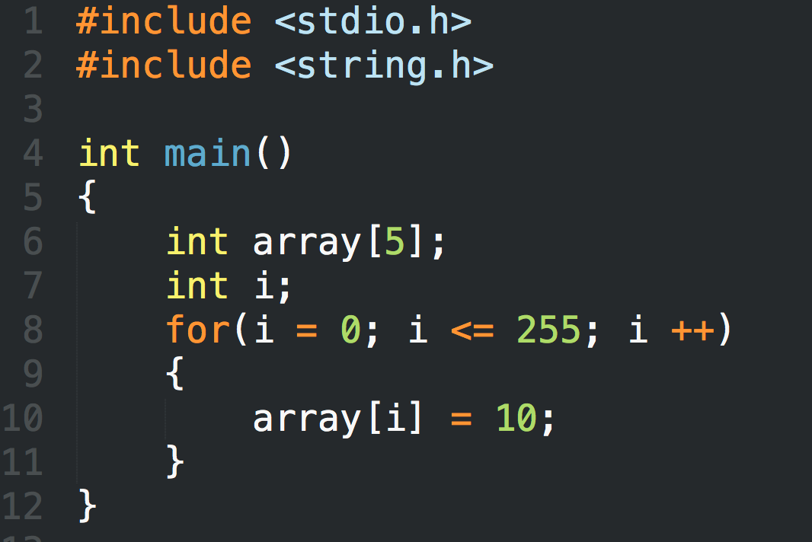
Another C programmer mistake

Slide 11
Crash report

Slide 12
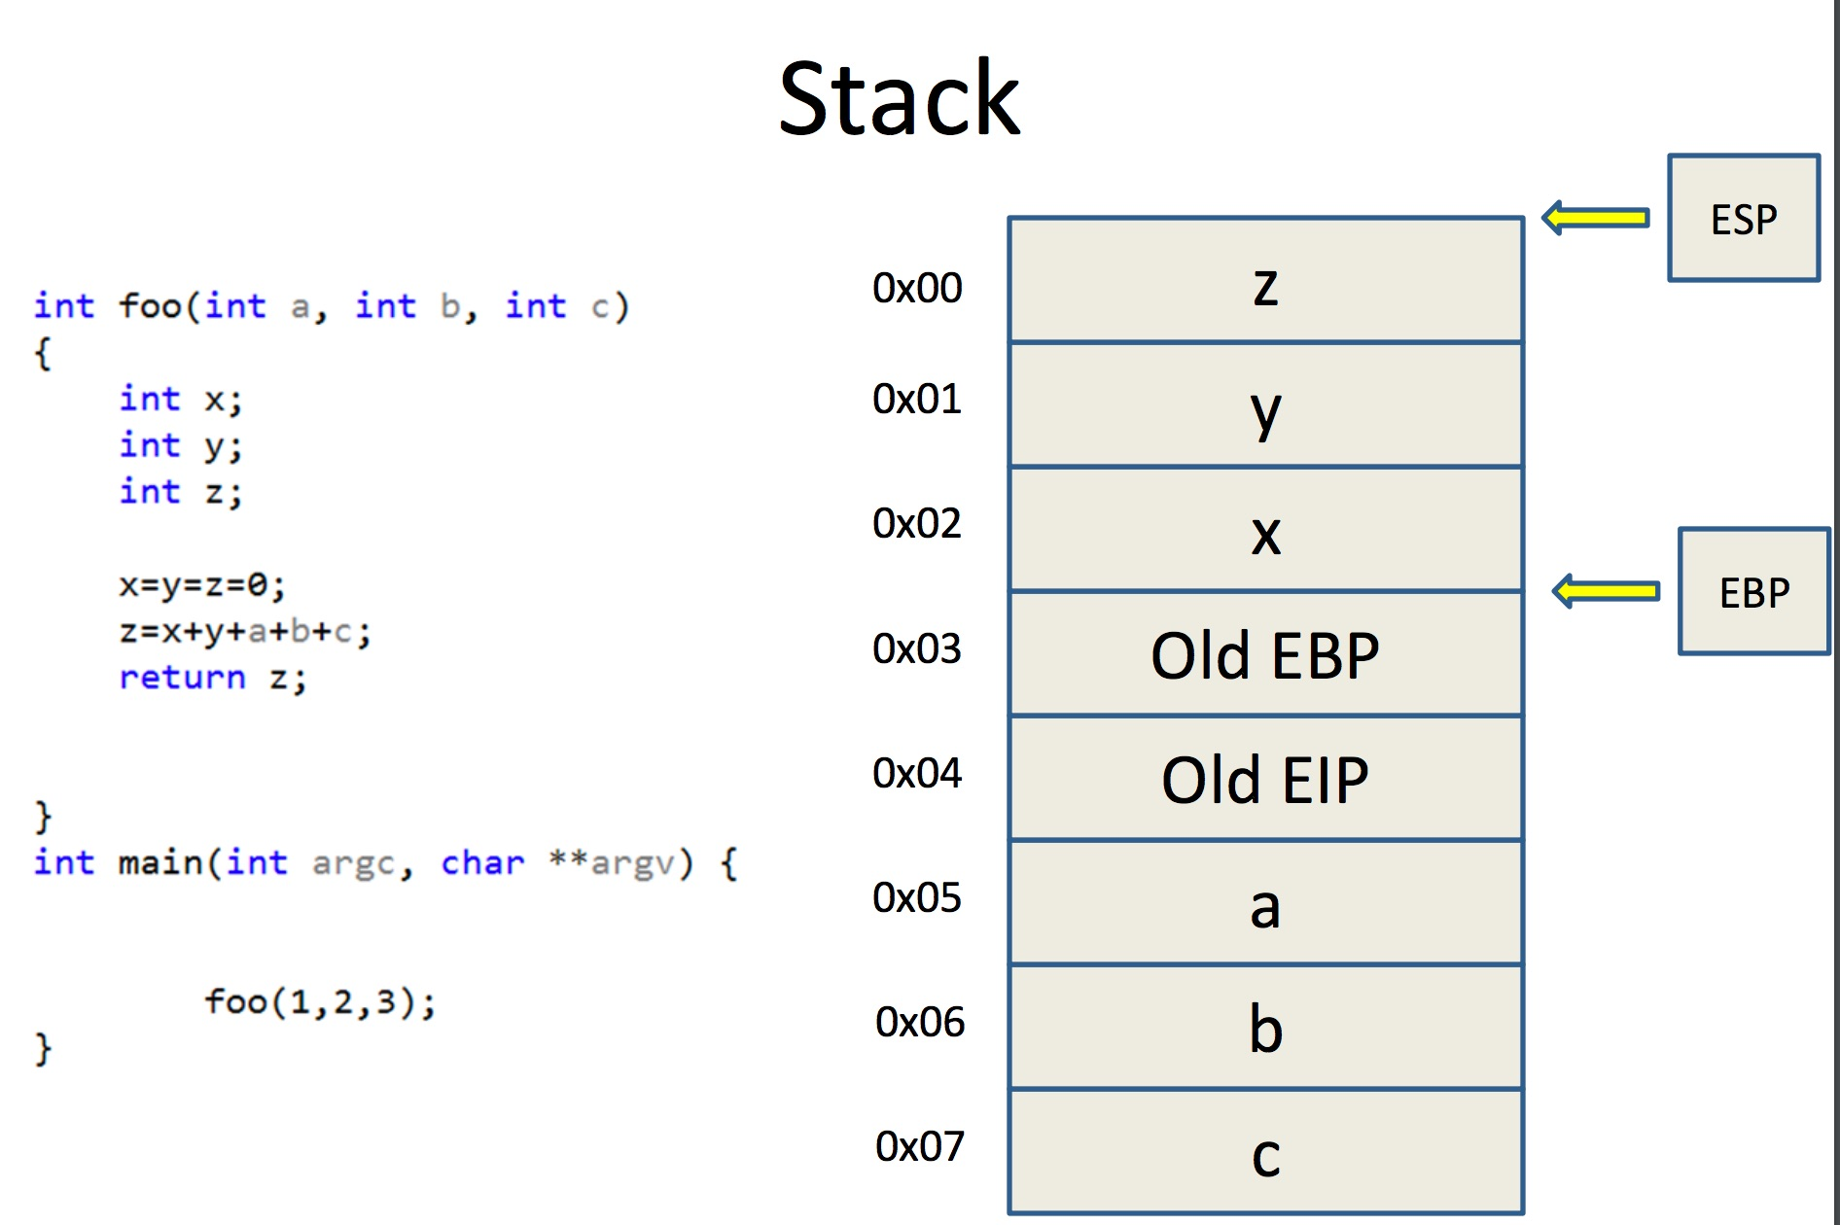

Slide 13
Stack Frame

Slide 14
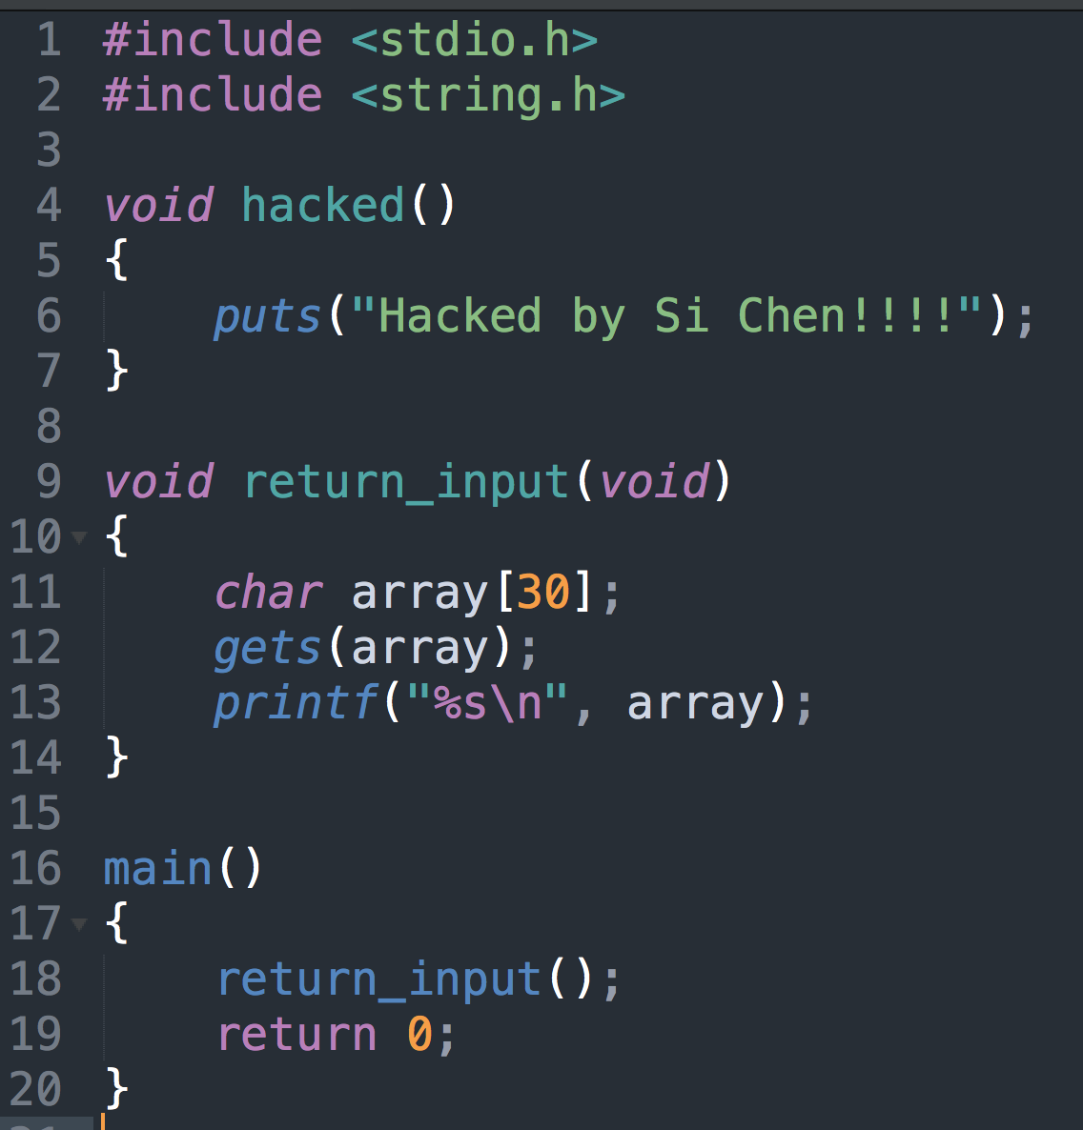
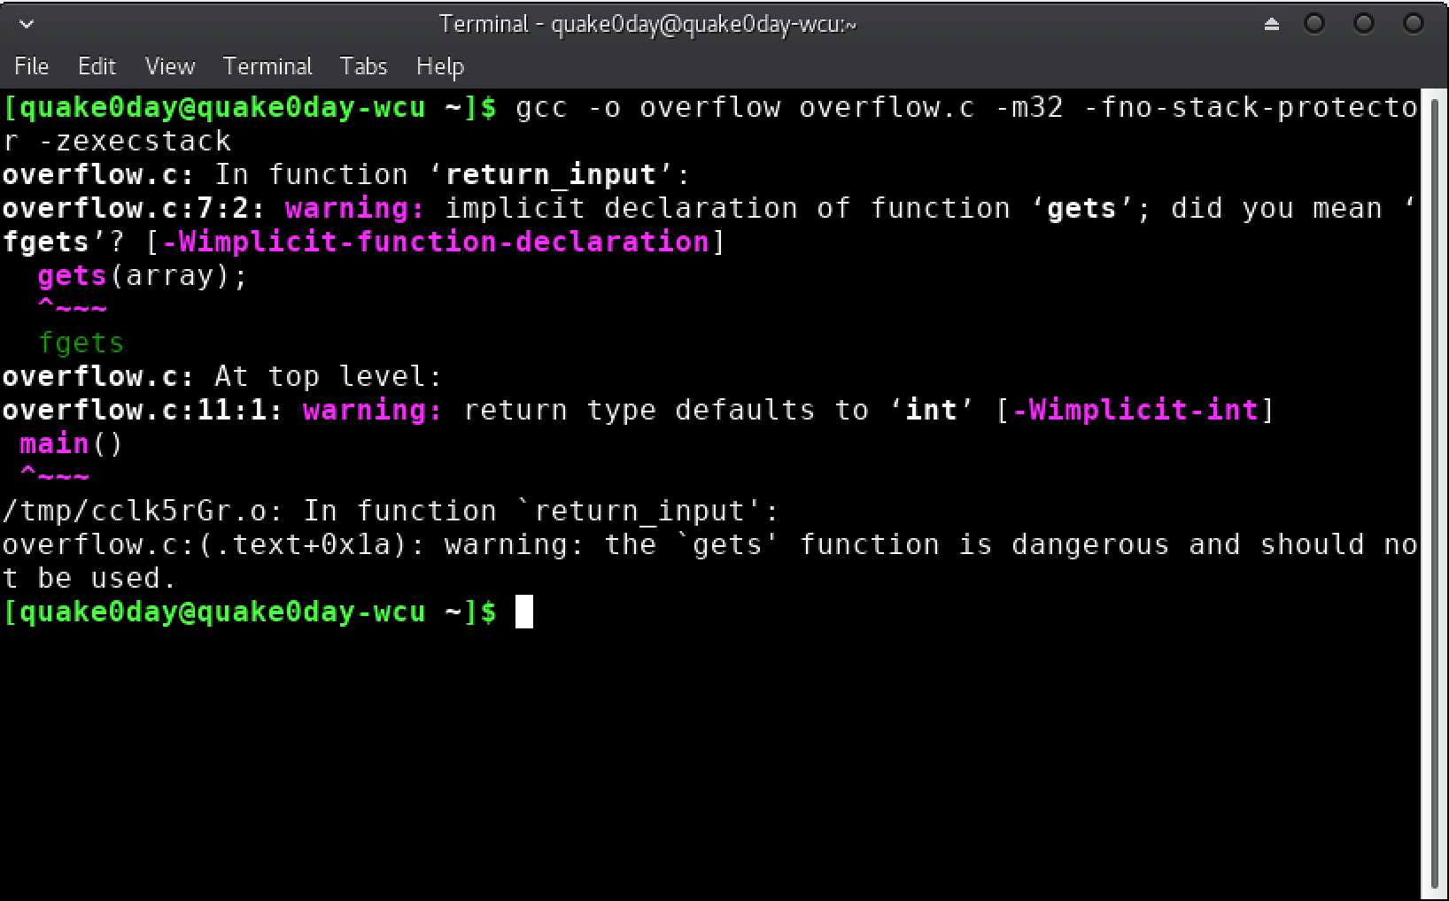
Overflow.c

Slide 15
Protection: ASLR, DEP, Stack Protector
Shutdown ASLR (Address space layout randomization)
-fno-stack-protector Shutdown stack protector
-z execstack Shutdown DEP(Data Execution Prevention)

Slide 16
Overflow.c

Slide 17
GNU Debugger - Basics
gdb
disassemble main (disas main)
set disassembly-flavor intel
break main (b main)
run
stepi (s), step into
nexti (n), step over

Slide 18
GNU Debugger – Examine Memory
Examine memory: x/NFU address
N = number
F = format
U = unit
• Examples
x/10xb 0xdeadbeef, examine 10 bytes in hex
x/xw 0xdeadbeef, examine 1 word in hex
x/s 0xdeadbeef, examine null terminated string

Slide 19
Return Hijack
The return address will be stored on stack when calling a new function. (EIP)
The local valuable will be store on the low address
If the variable is an array, and if we store too many data, it will cover the return address which store on the high address.

Slide 20
From Crash to Hack
If the input is larger than the size of the array, normally, the program will crash.
Need to craft special data to exploit this vulnerability.
The general idea is to overflow a buffer so that it overwrites the return address.
AAAA
AAAA
BBBB
BBBB
CCCC
CCCC
DDDD
New Return Address

Slide 21
Print ABCD

Slide 22
Print 100A(s)

Slide 23
BASH refresher

Slide 24
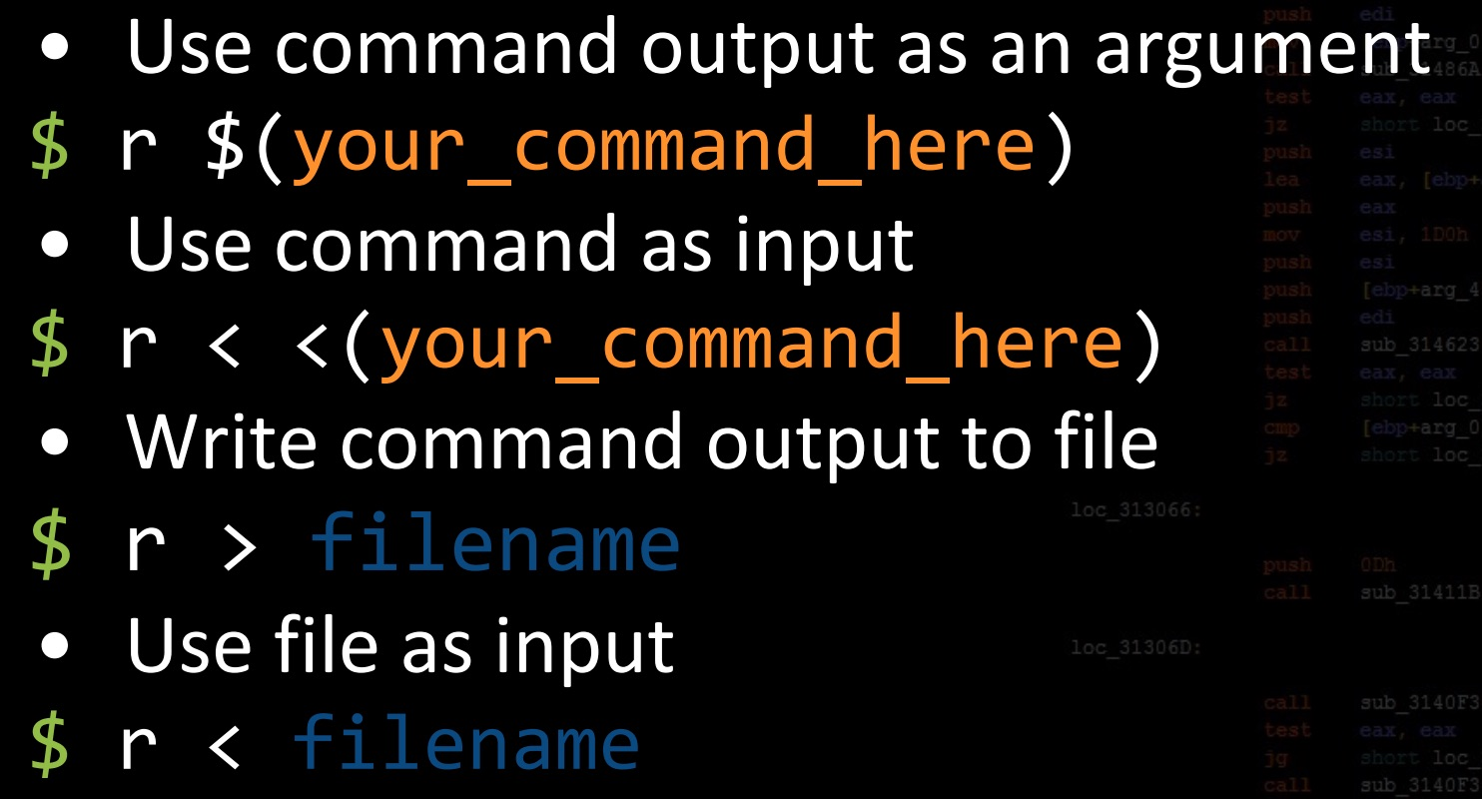
gdb io

Slide 25
Guessing Addresses
Typically you need the source code so you can estimate the address of both the buffer and the return-address.
An estimate is often good enough! (more on this in a bit).

Slide 26
Protection: ASLR, DEP, Stack Protector
Address Space Layout Randomization (ASLR) is a technology used to help prevent shellcode from being successful.
It does this by randomly offsetting the location of modules and certain in-memory structures.

Slide 27
Protection: ASLR, DEP, Stack Protector
Data Execution Prevention (DEP) prevents certain memory sectors, e.g. the stack, from being executed.
Stack protection will abort your program if it detects stack overflow.
Bypassing ASLR/DEP - exploit-db

Slide 28
Q & A

